Slide 1
UNIT-II

Slide 2

ER Design Issues
Choosing Entity Set vs Attributes
To understand this lets take an example, let’s say we have an entity set Student with attributes such as student-name and student-id. Now we can say that the student-id itself can be an entity with the attributes like student-class and student-section.
Now if we compare the two cases we discussed above, in the first case we can say that the student can have only one student id, however in the second case when we chose student id as an entity it implied that a student can have more than one student id.

Slide 3
ER Design Issues
Choosing Entity Set vs. Relationship Sets
It is hard to decide that an object can be best represented by an entity set or relationship set.
The user needs to understand whether the entity would need a new relationship if a requirement arise in future, if this is the case then it is better to choose entity set rather than relationship set.
A person takes a loan from a bank, here we have two entities person and bank and their relationship is loan.
This is fine until there is a need to disburse a joint loan, in such case a new relationship needs to be created to define the relationship between the two individuals who have taken joint loan.
In this scenario, it is better to choose loan as an entity set rather than a relationship set.

Slide 4
ER Design Issues
Choosing Binary vs n-ary Relationship Sets
In most cases, the relationships described in an ER diagrams are binary.
The n-ary relationships are those where entity sets are more than two, if the entity sets are only two, their relationship can be termed as binary relationship.
To describe a relationship between four family members: father, mother, son and daughter. This can easily be represented in forms of multiple binary relationships, father-mother relationship as “spouse”, son and daughter relationship as “siblings” and father and mother relationship with their child as “child”.

Slide 5
ER Design Issues
Placing Relationship Attributes
The cardinality ratio in DBMS can help us determine in which scenarios we need to place relationship attributes. It is recommended to represent the attributes of one to one or one to many relationship sets with any participating entity sets rather than a relationship set.
For example, if an entity cannot be determined as a separate entity rather it is represented by the combination of participating entity sets. In such case it is better to associate these entities to many-to-many relationship sets.

Slide 6
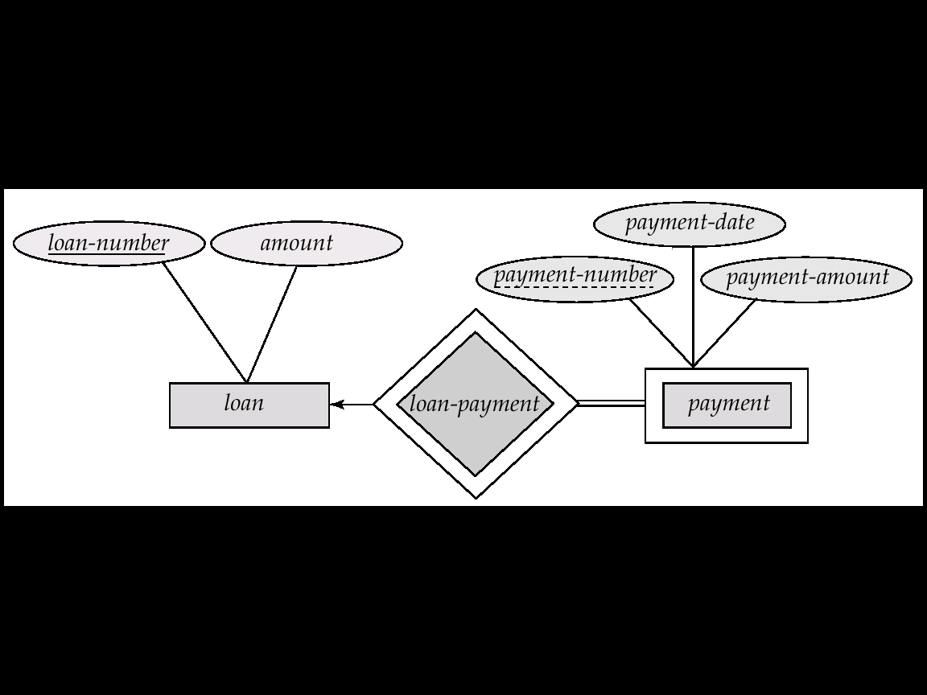
Weak Entity Sets
An entity set that does not have a primary key is referred to as a weak entity set.
We depict a weak entity set by double rectangles.
We underline the discriminator of a weak entity set with a dashed line.
payment-number – discriminator of the payment entity set
Primary key for payment – (loan-number, payment-number)

Slide 7
Relational Model
Notes:
7

Slide 8
Relational Model Concepts
A Relation is a mathematical concept based on the ideas of sets
The model was first proposed by Dr. E.F. Codd of IBM Research in 1970 in the following paper:
"A Relational Model for Large Shared Data Banks," Communications of the ACM, June 1970
The above paper caused a major revolution in the field of database management and earned Dr. Codd the coveted ACM Turing Award

Slide 9
Informal Definitions
Informally, a relation looks like a table of values.
A relation typically contains a set of rows.
The data elements in each row represent certain facts that correspond to a real-world entity or relationship
In the formal model, rows are called tuples
Each column has a column header that gives an indication of the meaning of the data items in that column
In the formal model, the column header is called an attribute name (or just attribute)

Slide 10
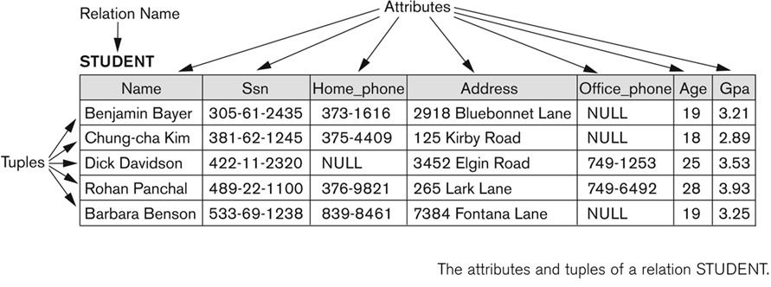
EXAMPLE

Slide 11
Informal Definitions (Cont..)
Key of a Relation:
Each row has a value of a data item (or set of items) that uniquely identifies that row in the table
Called the key
In the STUDENT table, SSN is the key
Sometimes row-ids or sequential numbers are assigned as keys to identify the rows in a table
Called artificial key or surrogate key

Slide 12
Formal Definitions - Schema
The Schema (or description) of a Relation:
Denoted by R(A1, A2, .....An)
R is the name of the relation
The attributes of the relation are A1, A2, ..., An
Example:
CUSTOMER (Cust-id, Cust-name, Address, Phone#)
CUSTOMER is the relation name
Defined over the four attributes: Cust-id, Cust-name, Address, Phone#
Each attribute has a domain or a set of valid values.
For example, the domain of Cust-id is 6 digit numbers.

Slide 13
Formal Definitions - Tuple
A tuple is an ordered set of values (enclosed in angled brackets ‘< … >’)
Each value is derived from an appropriate domain.
A row in the CUSTOMER relation is a 4-tuple and would consist of four values, for example:
<632895, "John Smith", "101 Main St. Atlanta, GA 30332", "(404) 894-2000">
This is called a 4-tuple as it has 4 values
A tuple (row) in the CUSTOMER relation.
A relation is a set of such tuples (rows)

Slide 14
Formal Definitions - Domain
A domain has a logical definition:
Example: “USA_phone_numbers” are the set of 10 digit phone numbers valid in the U.S.
A domain also has a data-type or a format defined for it.
The USA_phone_numbers may have a format: (ddd)ddd-dddd where each d is a decimal digit.
Dates have various formats such as year, month, date formatted as yyyy-mm-dd, or as dd mm,yyyy etc.
The attribute name designates the role played by a domain in a relation:
Used to interpret the meaning of the data elements corresponding to that attribute
Example: The domain Date may be used to define two attributes named “Invoice-date” and “Payment-date” with different meanings

Slide 15
Informal Terms |  | Formal Terms
Table |  | Relation
Column Header |  | Attribute
All possible Column Values |  | Domain
Row |  | Tuple
Table Definition |  | Schema of a Relation
Populated Table |  | State of the Relation

Slide 16
Conversion of an ER to Relational Tables
Primary keys allow entity sets and relationship sets to be expressed uniformly as tables which represent the contents of the database.
A database which conforms to an E-R diagram can be represented by a collection of tables.
For each entity set and relationship set there is a unique table which is assigned the name of the corresponding entity set or relationship set.
Each table has a number of columns (generally corresponding to attributes), which have unique names.
Converting an E-R diagram to a table format is the basis for deriving a relational database design from an E-R diagram.

Slide 17
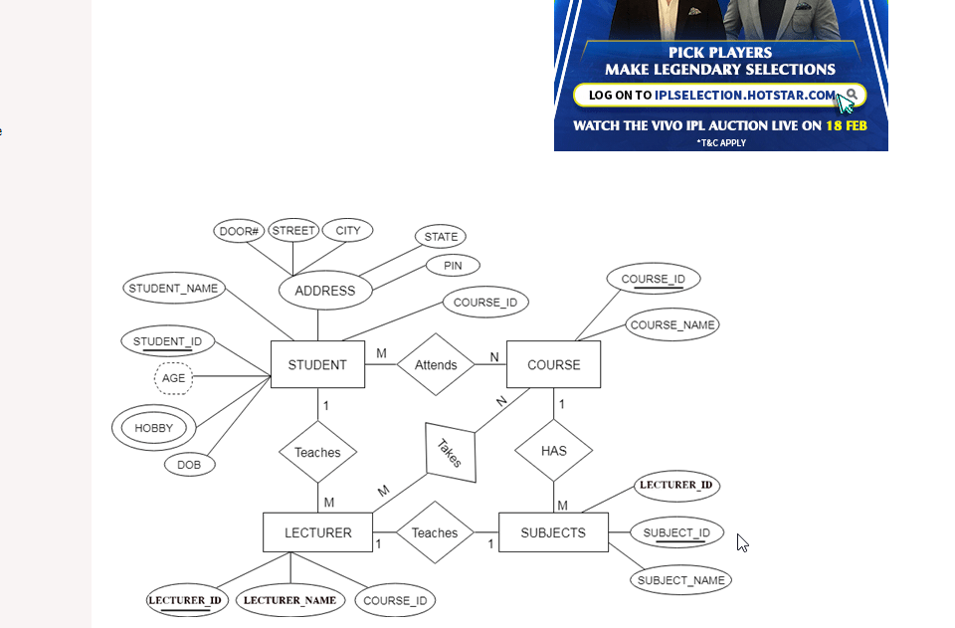
Entity type becomes a table.
In the given ER diagram, LECTURER, STUDENT, SUBJECT and COURSE forms individual tables.
All single-valued attribute becomes a column for the table.
In the STUDENT entity, STUDENT_NAME and STUDENT_ID form the column of STUDENT table. Similarly, COURSE_NAME and COURSE_ID form the column of COURSE table and so on.
A key attribute of the entity type represented by the primary key.
In the given ER diagram, COURSE_ID, STUDENT_ID, SUBJECT_ID, and LECTURE_ID are the key attribute of the entity.
The multivalued attribute is represented by a separate table.
In the student table, a hobby is a multivalued attribute. So it is not possible to represent multiple values in a single column of STUDENT table. Hence we create a table STUD_HOBBY with column name STUDENT_ID and HOBBY.

Slide 18
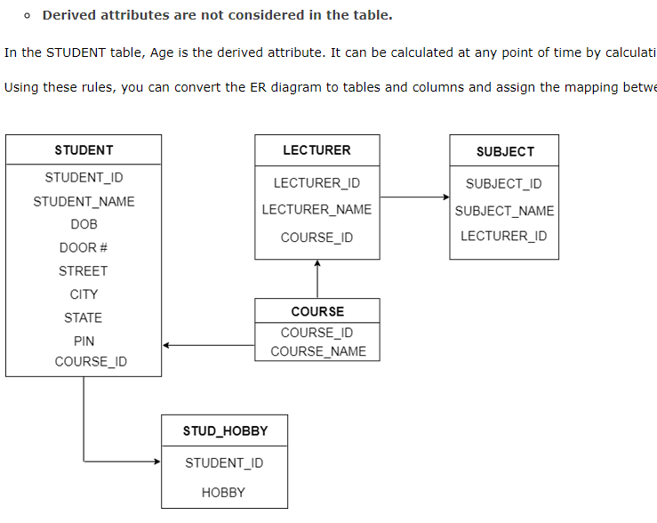
Composite attribute represented by components.
In the given ER diagram, student address is a composite attribute.
It contains CITY, PIN, DOOR#, STREET, and STATE. In the STUDENT table, these attributes can merge as an individual column.
Derived attributes are not considered in the table.
In the STUDENT table, Age is the derived attribute.
It can be calculated at any point of time by calculating the difference between current date and Date of Birth.
Using these rules, you can convert the ER diagram to tables and columns and assign the mapping between the tables.

Slide 19
Data Manipulation Language - DML
When we have to insert records into table or get specific record from the table, or need to change some record, or delete some record or perform any other actions on records in the database, we need to have some media to perform it.
DML helps to handle user requests. It helps to insert, delete, update, and retrieve the data from the database. Let us see some of them.
Select (where, group by, having Clauses)
Insert
Update
Delete

Slide 20
Select
Select command helps to pull the records from the tables or views in the database.
It either pulls the entire data from the table/view or pulls specific records based on the condition.
It can even retrieve the data from one or more tables/view in the database.

Slide 21
Cont.
SELECT * FROM table_name;
retrieves all the rows and columns from table table_name and displays it in tabular form.
SELECT COLUMN1, COLUMN2, COLUMN3 from table_name;
retrieves only 3 columns from table table_name
SELECT column1, column2, ... FROM table_name WHERE condition;
Example:
SELECT * FROM Customers WHERE Country='Mexico';
SELECT DISTINCT column1, column2, ... FROM table_name;

Slide 22
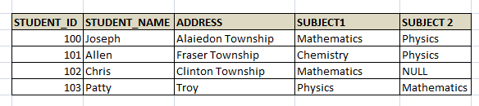
Activity - Problem Based Learning
Students are asked to give the result of the following queries.
SELECT * FROM STUDENT;
SELECT STUDENT_NAME, ADDRESS FROM STUDENT;
SELECT e.EMPLOYEE_NAME, e.ADDRESS, e.PHONE_NUMBER, d.DEPARTMENT_NAME FROM EMPLOYEE e, DEPARTMENT d WHERE E.DEPARTMENET_ID = D.DEPARTMENT_ID;

Slide 23
Cont.
SELECT column_list FROM table-name [WHERE Clause]
[GROUP BY clause]
[HAVING clause]
[ORDER BY clause];

Slide 24
WHERE
WHERE Clause - here we can specify the filter conditions to the query. We can add any number of conditions.

Slide 25
GROUP BY
In SQL, The Group By statement is used for organizing similar data into groups. The data is further organized with the help of equivalent function. It means, if different rows in a precise column have the same values, it will arrange those rows in a group.
The SELECT statement is used with the GROUP BY clause in the SQL query.
WHERE clause is placed before the GROUP BY clause in SQL.
ORDER BY clause is placed after the GROUP BY clause in SQL.

Slide 26
GROUP BY
Syntax:
SELECT column1, function_name(column2)
FROM table_name
WHERE condition
GROUP BY column1, column2
ORDER BY column1, column2;
function_name: Mainly used for name of the function, SUM(), AVG().Condition: condition we used.

Slide 27
GROUP BY
Sample Table:
Employee
S.no | Name | AGE | Salary
1 | JOHN | 24 | 25000
2 | NICK | 22 | 22000
3 | AMARA | 25 | 15000
4 | NICK | 22 | 22000
5 | JOHN | 24 | 25000

Slide 28
GROUP BY
SELECT NAME, SUM (SALARY) FROM Employee GROUP BY NAME;
FIND THE OUTPUT.

Slide 29
Some of the Group functions are
Count - It counts the total number of records in the table/s after applying ‘where’ clause. If where clause is not specified, it gives the total number of records in the table.
SUM – It totals the value in each numeric column. We can use this function to find the total marks of a student, total salary of an employee in a specific period etc.
AVG – It gives the average value of a column, provided column has numeric value. E.g.: Average age of students present in particular class.
MAX – It gives the maximum value in a column. For example, highest scorer in the class can be retrieved by MAX function.
MIN– It gives the minimum value in a column. For example, lowest paid employee in a department can be obtained by MIN.

Slide 30
Having Clause
WHERE clause is used for deciding purpose. It is used to place conditions on the columns to determine the part of the last result-set of the group. Here, we are not required to use the combined functions like COUNT (), SUM (), etc. with the WHERE clause. After that, we need to use a HAVING clause.
SYNTAX:
SELECT column1, function_name(column2)
FROM table_name
WHERE condition
GROUP BY column1, column2
HAVING condition
ORDER BY column1, column2;
function_name: Mainly used for name of the function, SUM(), AVG().
table_name: Used for name of the table.
condition: Condition used.

Slide 31
SELECT NAME, SUM(SALARY) FROM Employee
GROUP BY NAME
HAVING SUM(SALARY)>23000;

Slide 32
POINTS TO REMEMBER
The GROUP BY Clause is used to group the rows, which have the same values.
The SELECT statement in SQL is used with the GROUP BY clause.
In the Group BY clause, the SELECT statement can use constants, aggregate functions, expressions, and column names.

Slide 33
ORDER BY
This clause helps to sort the records that are retrieved. By default, it displays the records in ascending order of primary key. If we need to sort it based on different columns, then we need to specify it in ORDER BY clause. If we need to order by descending order, then DESC keyword has to be added after the column list.
SELECT * FROM EMPLOYEE ORDER BY EMPLOYEE_NAME DESC;
Displays all records in descending order of employee name

Slide 34
Activity (Problem Based Learning)
Reg.No. | Name | Marks
191611001 | Raj | 98
191611002 | Azar | 99
191611003 | Arun | 100
191611004 | Kumar | 95
191611005 | Bala | 96
191611006 | Reddy | 98
191611007 | Jackson | 96
Students are asked to write a all group function for the above student table and they give the output for each group function

Slide 35
Insert
Insert statement is used to insert new records into the table. The general syntax for insert is as follows:
Syntax:
INSERT INTO TABLE_NAME (col1, col2, col3,...colN) VALUES (value1, value2, value3,...valueN);
It inserts value to each column from 1 to N. When we insert the data in this way, we need to make sure datatypes of each column matches with the value we are inserting. Else, data will not be inserted or will insert wrong values. Also, if there is any foreign key constraint on the table, then we have to make sure foreign key value already exists in the parent table.
Example:
INSERT INTO EMPLOYEE (EMP_ID, EMP_NAME, ADDRESS, DEPT_ID) VALUES (10001, ‘Joseph’, ‘Troy’, 11101); -- Here dept_id 11101 is a foreign key and it has be in

Slide 36
Update
Update statement is used to modify the data value in the table. General syntax for update is as below:
Syntax
UPDATE table_name SET column_name1 = value1, column_name2 = value2, ... column_nameN = valueN, [WHERE condition]

Slide 37
Example
Imagine, an employee has changed his address and it needs to be updated in the Employee table.
UPDATE EMPLOYEE SET ADDRESS = ‘Clinton Township’ WHERE EMP_ID = 10110;
Salary Updating
UPDATE EMPLOYEE SET Salary = salary+ (salary*0.1);

Slide 38
Delete
Using Delete statement, we can delete the records in the entire table or specific record by specifying the condition.
Syntax
DELETE FROM table_name [WHERE condition];
Example
DELETE FROM EMPLOYEE WHERE EMP_ID = 110;

Slide 39
Activity
Student are asked to create a table and they should insert values into the table and perform the update operation in the same table.

Slide 40
Data Control Language (DCL)
DCL languages are used to control the user access to the database, tables, views, procedures, functions and packages. They give different levels of access to the objects in the database.

Slide 41
GRANT
GRANT provides the privileges to the users on the database objects. The privileges could be select, delete, update and insert on the tables and views. On the procedures, functions and packages it gives select and execute privileges. We can either give all the privileges or any one or more privileges to the objects. The syntax of GRANT is as below:
GRANT privilege_name ON object_name TO {user_name |PUBLIC |role_name} [WITH GRANT OPTION];

Slide 42
Cont.
Privilege_name is the level of access given to the users. Some of the access rights are ALL, DELETE, UPDATE, INSERT, EXECUTE and SELECT.
Object_name is the name of a database object like TABLE, VIEW, PROCEDURE, FUNCTION, PACKAGE and SEQUENCE.
User_name is the name of the user to whom an access is being granted.
PUBLIC is used to grant access rights to all users.
ROLES are a set of privileges grouped together.
WITH GRANT OPTION - allows a user to grant access rights to other users. i.e.; usually grants are given by the user who has created the database objects. But with this option, the users who have got the access rights can also provide the grants and access to other tables/views.

Slide 43
Example
GRANT SELECT, INSERT ON STUDENT TO Mathew;
Here SELECT and INSERT grants are given to Mathew on STUDENT table.

Slide 44
REVOKE
REVOKE removes the privileges given on the database objects. We can remove all the privileges or remove one or more privileges from the objects.
Syntax
REVOKE privilege_name ON object_name FROM {user_name |PUBLIC |role_name}
Example
REVOKE INSERT ON STUDENT FROM Mathew;
Removes the INSERT grant from Mathew on STUDENT Table

Slide 45
Transaction Control Language (TCL)
Suppose we have inserted some records in to Employee table. Now we need to save them. How?
Similarly, we have updated something wrong on the table. After updating we realized that its wrong. Now we need to unsave the changes that have been done. How?
We have deleted something or inserted something which is not correct. It has to be undone.
All these saving and undoing the tasks can be done by TCL. Some of the commands in TCLs are as below:

Slide 46
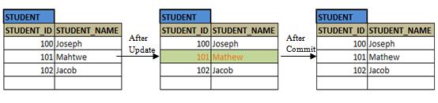
COMMIT
COMMIT saves the transaction on the database. The transaction can be insert, delete or update. Once the COMMIT is issued, the changes are saved permanently in the database. It cannot be undone.
UPDATE STUDENT SET STUDENT_NAME = ‘Mathew’ WHERE STUDENT_NAME = ‘Mahtwe’; COMMIT;

Slide 47
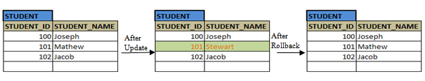
ROLLBACK
ROLLBACK command is used to undo the insert, delete or update transaction in the database. It undoes the transaction performed on the table and restores the previous stored value.
UPDATE STUDENT SET STUDENT_NAME = ‘Stewart’ WHERE STUDENT_NAME = ‘Mathew; ROLLBACK;

Slide 48
SAVEPOINT
Savepoint is a command in SQL that is used with the rollback command.
It is a command in Transaction Control Language that is used to mark the transaction in a table.
Consider you are making a very long table, and you want to roll back only to a certain position in a table then; this can be achieved using the savepoint.
If you made a transaction in a table, you could mark the transaction as a certain name, and later on, if you want to roll back to that point, you can do it easily by using the transaction's name.
Savepoint is helpful when we want to roll back only a small part of a table and not the whole table. In simple words, we can say savepoint is a bookmark in SQL.

